Slide 1
Image Enhancement and Frequency Domain
By Ramakant Ganjeshwar

Slide 2
Image Enhancement
Image Enhancement can be done by applying filters an the real image.
Here filter is used to smoothen and sharpening of image by removing very high and low frequency component.
This change taken place at whole image unlike enhancement in spatial domain.
So we will have two filters
Low Pass filters
High pass filters

Slide 3
Low pass filters
It Remove all high frequency component from the image and only keeps low frequency component of image.
This filter mainly use to smoothen the image and blurring the image.
This is use to Remove the noise from the image.

Slide 4
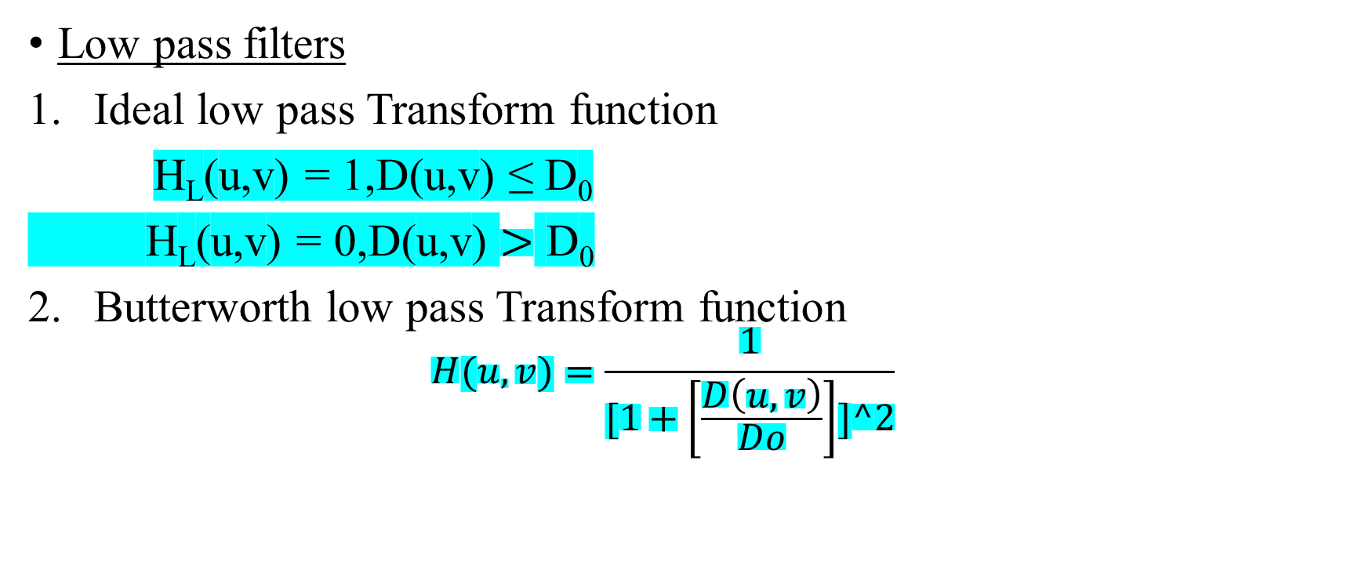
Types of low pass
Low pass filters
Ideal low pass Transform function
H_{L}(u,v) = 1,D(u,v) ≤ D₀
H_{L}(u,v) = 0,D(u,v) $>$ D₀
Butterworth low pass Transform function
$$H(u,v)=\frac{1}{[1+\left[\frac{D\left(u,v\right)}{Do}\right]]^2}$$

Slide 5

Types of low pass
3. Gaussian low pass Transform
$$H(u,v)= e^{−D^{2\left(u,v\right)}/2D0^2}$$

Slide 6
High Pass filters
It removes all low frequency component to from the image and only keeps. high frequency component of the image.
This filter mainly use sharpening the image.
This type of image will not have background.

Slide 7
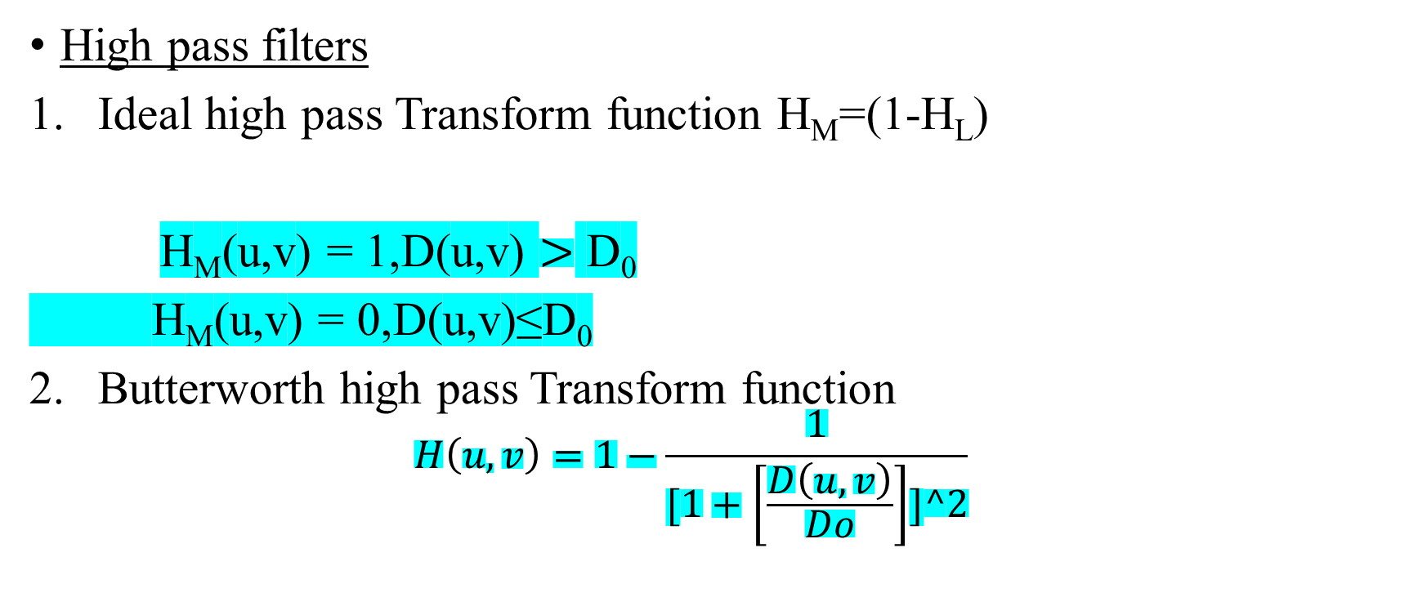
Types of High pass
High pass filters
Ideal high pass Transform function H_{M}=(1-H_{L})
H_{M}(u,v) = 1,D(u,v) $>$ D₀
H_{M}(u,v) = 0,D(u,v)≤D₀
Butterworth high pass Transform function
$$H\left(u,v\right)=1−\frac{1}{[1+\left[\frac{D\left(u,v\right)}{Do}\right]]^2}$$

Slide 8

Types of High pass
3. Gaussian High pass Transform
$$H\left(u,v\right)=1−e^{−D^{2\left(u,v\right)}/2D0^2}$$

